Slide 1

CoolTshirts.com
Learn SQL from Scratch
Luis F Rodriguez
08/3/2018

Slide 2
Example Table of Contents
Get familiar with CoolTShirts
What is the user journey?
Optimize the campaign budget

Slide 3
1. Getting Familiar With CoolTshirts.com

Slide 4
1.1 Current Campaigns and Sources
CoolTShirts.com is currently running 8 different campaigns across 6 different sources. A utm source is where that campaign is running, for example currently CoolTShirts marketing department is sending two different campaigns over email, one being its newsletter and the other being a retargeting campaign.
Using this data you would be able to eventually see what source would be your most effective by examining the performance of your campaigns over a long term.
In the short term you could get more granular by examining the performance of each individual campaign and perhaps run them at different sources if they are compatible. An example would be running your current most effective paid ad campaign on your historical highest performing source.

Slide 5
1.1 Current Campaigns and Sources (CODE)
/* Question 1 */
/*A1*/
SELECT COUNT(DISTINCT utm_campaign)
FROM page_visits
UNION
SELECT DISTINCT utm_campaign
FROM page_visits;
/*A2*/
SELECT COUNT (DISTINCT utm_source)
FROM page_visits
UNION
SELECT DISTINCT utm_source
FROM page_visits;
/*A3*/
SELECT DISTINCT utm_campaign, utm_source
FROM page_visits;

Slide 6
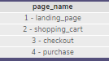
1.2 Pages On The Site
Currently they are monitoring a total of four different pages.

Slide 7
1.2 Current Campaigns and Sources (CODE)
SELECT DISTINCT page_name
FROM page_visits;

Slide 8
2. What is the user journey?

Slide 9
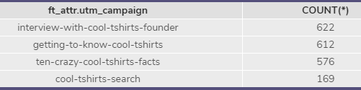
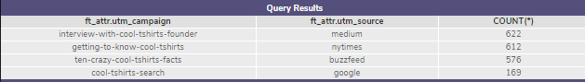
2.1 First-Touches per campaign.
I made sure to check for both the campaign itself and with the source as the same campaign may be run on multiple sources. (.sql file has both queries)
WITH first_touch AS (
SELECT user_id,
MIN(timestamp) as first_touch_at
FROM page_visits
GROUP BY user_id
),
ft_attr AS (
SELECT ft.user_id,
ft.first_touch_at,
pv.utm_campaign
FROM first_touch ft
JOIN page_visits pv
ON ft.user_id = pv.user_id
AND ft.first_touch_at = pv.timestamp
)
SELECT ft_attr.utm_campaign,
COUNT(*)
FROM ft_attr
GROUP BY 1
ORDER BY 2 DESC;

Slide 10
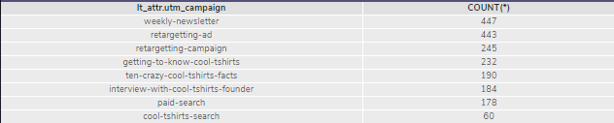
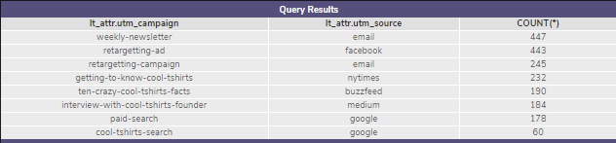
2.2 Last-Touches per campaign.
I made sure to check for both the campaign itself and with the source as the same campaign may be run on multiple sources. (.sql file has both queries)
WITH last_touch AS (
SELECT user_id,
MAX(timestamp) as last_touch_at
FROM page_visits
GROUP BY user_id
),
lt_attr AS (
SELECT lt.user_id,
lt.last_touch_at,
pv.utm_campaign
FROM last_touch lt
JOIN page_visits pv
ON lt.user_id = pv.user_id
AND lt.last_touch_at = pv.timestamp
)
SELECT lt_attr.utm_campaign,
COUNT(*)
FROM lt_attr
GROUP BY 1
ORDER BY 2 DESC;

Slide 11
2.3 Number Of Visitors Who Make A Purchase.
WITH buyers AS (
SELECT page_name, user_id
FROM page_visits
WHERE page_name = '4 - purchase'
Group BY user_id)
SELECT COUNT(user_id) as 'USERS WHO MADE A PURCHASE'
FROM buyers;

Slide 12
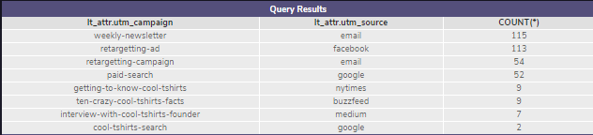
2.4 Campaigns With Last-Touches on Purchase Page
WITH last_touch AS (
SELECT user_id, page_name,
MAX(timestamp) as last_touch_at
FROM page_visits
WHERE page_visits.page_name = '4 - purchase'
GROUP BY user_id
),
lt_attr AS (
SELECT lt.user_id,
lt.last_touch_at,
pv.utm_campaign, pv.utm_source
FROM last_touch lt
JOIN page_visits pv
ON lt.user_id = pv.user_id
AND lt.last_touch_at = pv.timestamp
)
SELECT lt_attr.utm_campaign, lt_attr.utm_source,
COUNT(*)
FROM lt_attr
GROUP BY 1,2
ORDER BY 3 DESC;

Slide 13

2.5 Typical Customer Journey
Based off the data it’s very likely that a visitor would be very likely to come from interview-with-cool-tshirts-founder, getting-to-know-cool-tshirts, or the ten-crazy-cool-tshirts-facts campaigns. They’re the top performing lead acquisition campaigns with similar results in terms of attracting brand new customers.
As clients are funneled through their customer journey eventually we notice that the weekly-newsletter, retargeting-ad,retargeting-campaign, and paid search are responsible for eventually bringing in the revenue by getting the customer to the purchase page.

Slide 14
3. How to optimize the campaign budget.

Slide 15
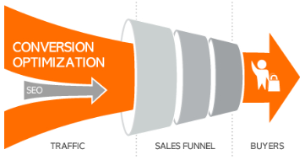
2.5 Typical Customer Journey
I understand that the cost of lead acquisition tends to be the highest so it is in the best interest of the company to become more efficient in converting the clients they already have in their pipeline.
I would choose to invest in the following four campaigns in order to focus on conversion: Weekly-newsletter, retargetting-ad, retargetting-campaign, paid search.
The 5th campaign I would choose would be focused on new customer acquisition: Interview-with-cool-tshirts-founder.

